Slide 1
Introduction to Matlab DIP toolbox
Associate Professor Qingfeng Zhang (张庆丰)
tqfz@jnu.edu.cn

Slide 2
Outline
Introduction to MATLAB
  Basics & Examples
Image Processing with MATLAB
  Basics & Examples
Notes:
Firstly, I will talk about some basics of MATLAB, including the development environment, basic operations and syntax of MATLAB language, so that we can have a big picture of MATLAB.
Then, I will focus on the image processing issues with MATLAB.
At the end, I will give some more examples for demonstration.

Slide 3
What is MATLAB?
MATLAB = Matrix Laboratory
“MATLAB is a high-level language and interactive environment that enables you to perform computationally intensive tasks faster than with traditional programming languages such as C, C++ and Fortran.” (www.mathworks.com)
MATLAB is an interactive, interpreted language that is designed for fast numerical matrix calculations
Notes:
MATLAB stands for..

Slide 4
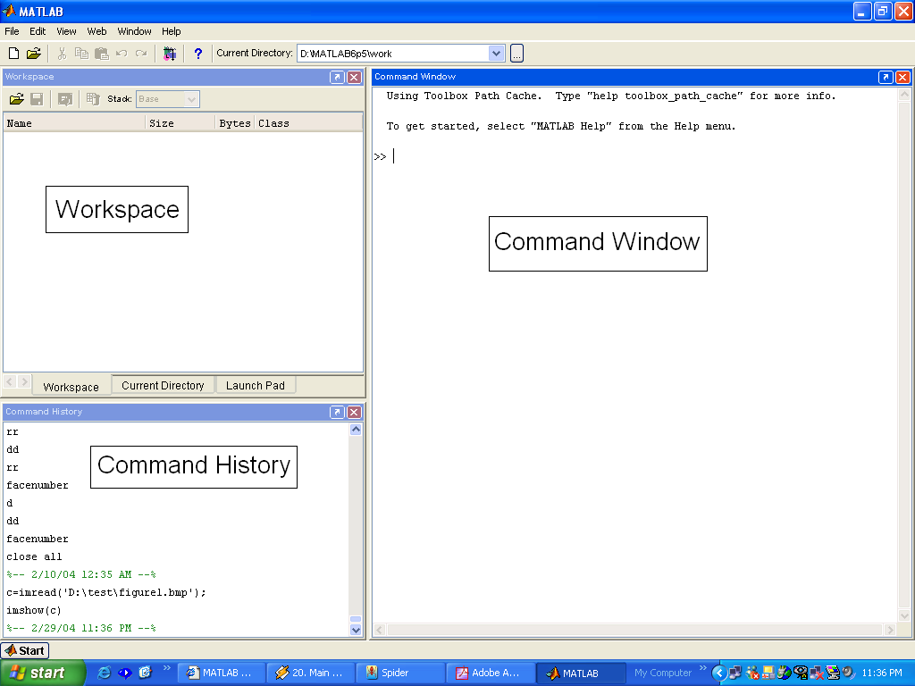
The MATLAB Environment
MATLAB window components:
  Workspace
    > Displays all the defined variables
  Command Window
    > To execute commands in the MATLAB environment
  Command History
    > Displays record of the commands used
  File Editor Window
  > Define your functions

Slide 5
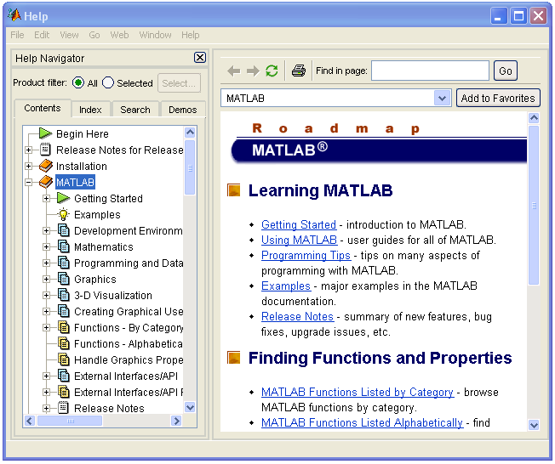
MATLAB Help
MATLAB Help is an extremely powerful assistance to learning MATLAB
Help not only contains the theoretical background, but also shows demos for implementation
MATLAB Help can be opened by using the HELP pull-down menu

Slide 6
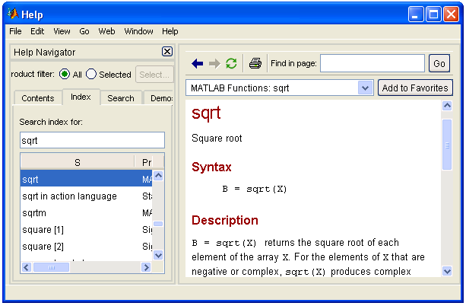
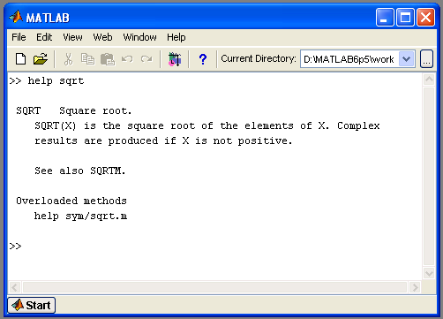
MATLAB Help (cont.)
Any command description can be found by typing the command in the search field
As shown above, the command to take square root (sqrt) is searched
We can also utilize MATLAB Help from the command window as shown

Slide 7
More about the Workspace
who, whos – current variables in the workspace
save – save workspace variables to *.mat file
load – load variables from *.mat file
clear – clear workspace variables

Slide 8
Matrices in MATLAB
Matrix is the main MATLAB data type
How to build a matrix?
  A=[1 2 3; 4 5 6; 7 8 9];
  Creates matrix A of size 3 x 3
Special matrices:
  zeros(n,m), ones(n,m), eye(n,m), rand(), randn()
Numbers are always double (64 bits) unless you specify a different data type
Notes:
After looking through the developing environment, let’s have a look at MATLAB language itself

Slide 9
Basic Operations on Matrices
All operators in MATLAB are defined on matrices: +, -, *, /, ^, sqrt, sin, cos, etc.
Element-wise operators defined with a preceding dot: .*, ./, .^
size(A) – size vector
sum(A) – columns sums vector
sum(sum(A)) – sum of all the elements

Slide 10
Variable Name in Matlab
Variable naming rules
- must be unique in the first 63 characters
- must begin with a letter
- may not contain blank spaces or other types of punctuation
- may contain any combination of letters, digits, and underscores
- are case-sensitive
- should not use Matlab keyword
Pre-defined variable names
  pi

Slide 11
Logical Operators
==, <, >, (not equal) ~=, (not) ~
find(‘condition’) – Returns indexes of A’s elements that satisfy the condition

Slide 12
What is the Image Processing Toolbox?
The Image Processing Toolbox is a collection of functions that extend the capabilities of the MATLAB’s numeric computing environment. The toolbox supports a wide range of image processing operations, including:
  Geometric operations
  Neighborhood and block operations
  Linear filtering and filter design
  Transforms
  Image analysis and enhancement
  Binary image operations
  Region of interest operations

Slide 13
Images in MATLAB
MATLAB can import/export several image formats:
  BMP (Microsoft Windows Bitmap)
  GIF (Graphics Interchange Files)
  HDF (Hierarchical Data Format)
  JPEG (Joint Photographic Experts Group)
  PCX (Paintbrush)
  PNG (Portable Network Graphics)
  TIFF (Tagged Image File Format)
  XWD (X Window Dump)
  raw-data and other types of image data
Typically switch images to double to perform any processing and convert back to unsigned integer
Data types in MATLAB
  Double (64-bit double-precision floating point)
  Single (32-bit single-precision floating point)
  Int32 (32-bit signed integer)
  Int16 (16-bit signed integer)
  Int8 (8-bit signed integer)
  Uint32 (32-bit unsigned integer)
  Uint16 (16-bit unsigned integer)
  Uint8 (8-bit unsigned integer)

Slide 14
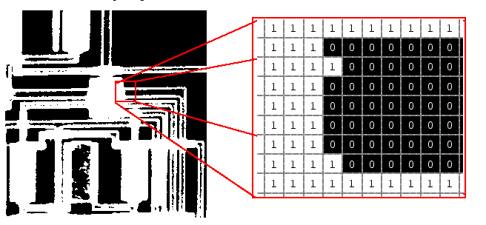
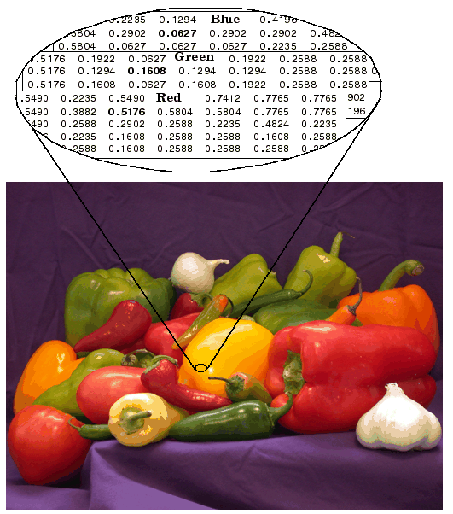
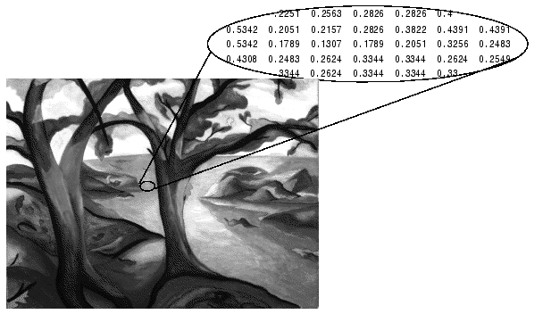
Images in MATLAB
• Binary images : {0,1}
• Intensity images : [0,1] or uint8, double etc.
• RGB images : m × n × 3
• Multidimensional images: m × n × p (p is the number of layers)

Slide 15
Images in Matlab
Matlab is optimised for operating on matrices
Images are matrices!
Many useful built-in functions in the Matlab Image Processing Toolbox
Very easy to write your own image processing functions

Slide 16

Images and Matrices
[0, 0]
How to build a matrix
(or image)?
Intensity Image:
  row = 256;
  col = 256;
  img = zeros(row, col);
  img(100:105, :) = 0.5;
  img(:, 100:105) = 1;
  figure;
  imshow(img);
o
Row 1 to 256
o
Column 1 to 256
[256, 256]

Slide 17
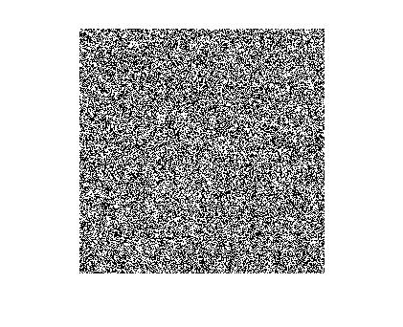
Images and Matrices
Binary Image:
row = 256;
col = 256;
img = rand(row, col);
img = round(img);
figure;
imshow(img);
size(im)

Slide 18
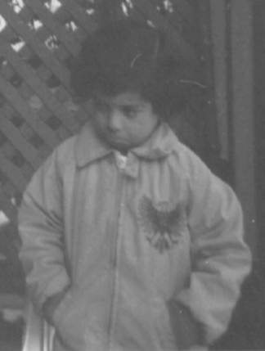
Built-in images in Matlab
All built-in images in matlab are in the subfolder:
~\MATLAB7\toolbox\images\imdemos
(different path depending on the version)
All the built-in images can be used in command by simply inputting the filename
excluding the path.
ex: I = imread('pout.tif');
The file pout.tif is a built-in image.

Slide 19
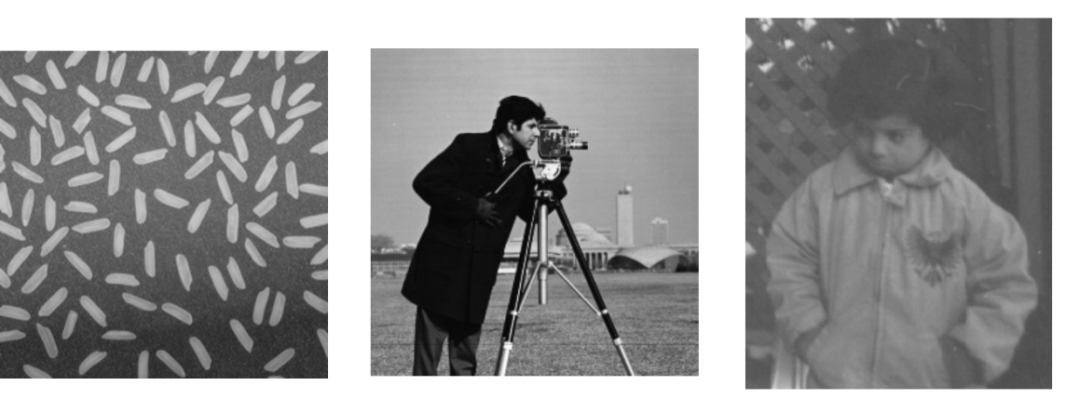
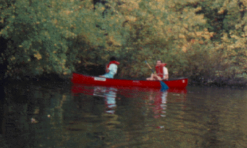
Built-in images in Matlab
Some examples of built-in images:
rice.png
cameraman.tif
pout.tif
canoe.tif

Slide 20
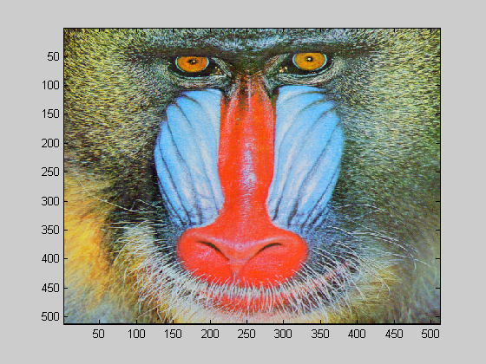

Loading and displaying images
>> I=imread('mandrill.bmp','bmp'); % load image
>> image(I) % display image
>> whos I
Name Size Bytes Class
I 512x512x3 786432 uint8 array
Grand total is 786432 elements using 786432 bytes
image format as a string
Matrix with image data
image filename as a string
Matlab can only perform arithmetic operations on data with class double!
Display the left half of the mandrill image
Dimensions of I (red, green and blue intensity information)

Slide 21
Representation of Images
Images are just an array of numbers
>> I % ctrl+c to halt output!
Intensity of each pixel is represented by the pixel element’s value in the red, green and blue matrices
>> I(1,1,:) % RGB values of element (1,1)
ans(:,:,1) =
135
ans(:,:,2) =
97
ans(:,:,3) =
33
Red
Images where the pixel value in the image represents the intensity of the pixel are called intensity images.
Green
Blue

Slide 22
Different Image Types
Indexed images
Intensity (grayscale) images
Binary images
RGB (true-color) images

Slide 23
Indexed images
An indexed image is where the pixel values are indices to elements in a colour map or colour lookup table.
The colour map will contain entries corresponding to red, green and blue intensities for each index in the image.
>> jet(20) % Generate a jet colourmap for 20 indices
ans =
0 0 0.6000
0 0 0.8000
0 0 1.0000
0 0.2000 1.0000
0 0.4000 1.0000
0 0.6000 1.0000
0 0.8000 1.0000
0 1.0000 1.0000
0.2000 1.0000 0.8000
0.4000 1.0000 0.6000
0.6000 1.0000 0.4000
0.8000 1.0000 0.2000
1.0000 1.0000 0
1.0000 0.8000 0
1.0000 0.6000 0
1.0000 0.4000 0
1.0000 0.2000 0
1.0000 0 0
0.8000 0 0
0.6000 0 0
3 4 7 3 6 1 9 8 9 1 2
5 6 14 4 2 5 6 1 4 5
2 8 9 4 2 13 7 8 4 5
5 1 11 5 6 4 1 7 4 4
1 9 5 6 5 5 1 4 4 6 5
5 9 2 1 11 1 3 6 1 9
7 6 8 18 1 8 1 9 1 3 3
9 2 3 7 2 9 8 1 6 6 4
7 8 6 7 4 15 8 2 1 3
7 5 10 8 4 10 4 3 6 4
RGB Entry for index value 3
Values can range from 0.0 to 1.0
Red, green and blue intensities of the nearest index in the colourmap are used to display the image.

Slide 24
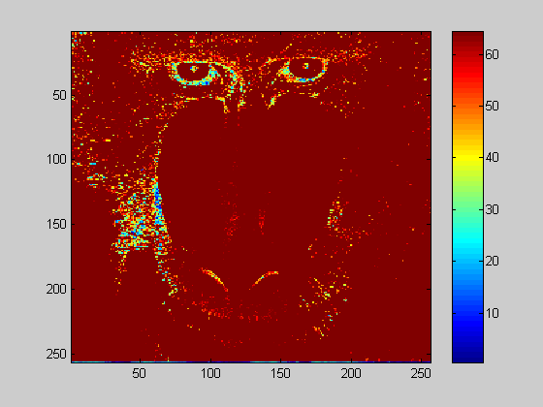
Displaying indexed images
>> I2=I(:,:,2); % green values of I
>> image(I2)
>> colorbar % display colourmap
Matlab considers I2 as an indexed image as it doesn’t contain entries for red, green and blue entries
Index
Associated color
Colour
Lookup Table

Slide 25
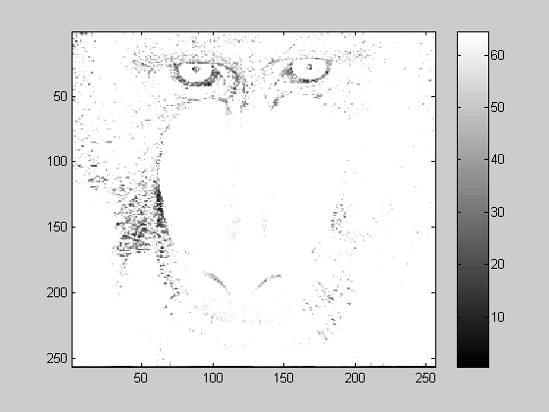
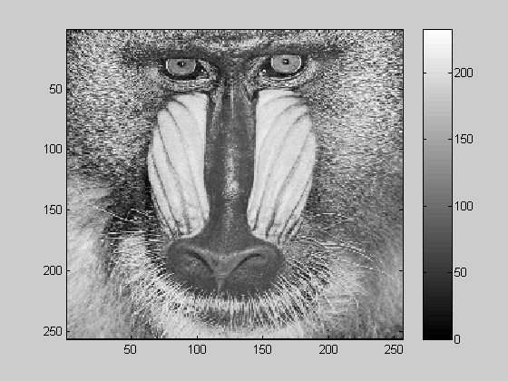
Displaying indexed images (continued)
Red =1.0, Green = 1.0, Blue =1.0, corresponds to index 64
change colourmap
>> colormap(gray)
scale colourmap
>> imagesc(I2)
Red =0.0, Green = 0.0, Blue = 0.0, corresponds to index 1
Type >>help graph3d to get a list of built-in colourmaps. Experiment with different built-in colourmaps.
Define your own colourmap mymap by creating a matrix (size m x 3 ) with red, green, blue entries. Display an image using your colourmap.
Red =1.0, Green = 1.0, Blue =1.0, corresponds to index 255
Red =0.0, Green = 0.0, Blue = 0.0, corresponds to index 0

Slide 26
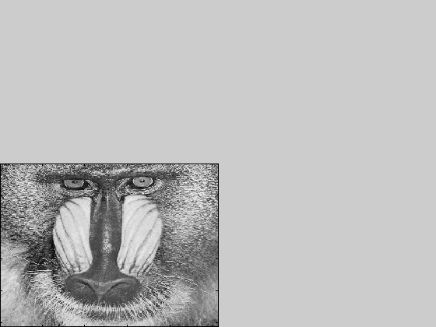
Useful functions for displaying images
>> axis image % plot fits to data
>> h=axes('position', [0 0 0.5 0.5]);
>> axes(h);
>> imagesc(I2)
Investigate axis and axes functions using Matlab’s help

Slide 27
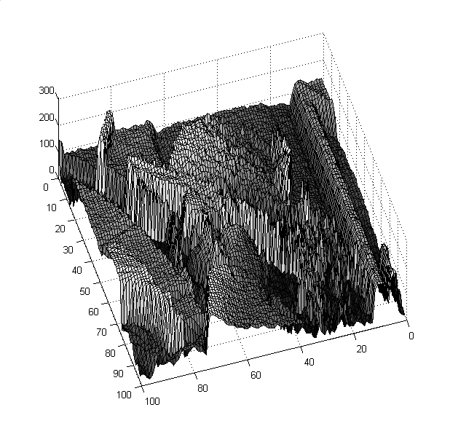
Visualising the intensity surface
>>surf(double(imresize(Lena(:,:,2),[50 50])))
Change type to double precision
Remember to reduce size of image!
Use Matlab’s built-in mesh and shading surface visualisation functions
Image Processing using Matlab Sumitha Balasuriya

Slide 28

Useful functions
Convert polar coordinates to cartesian coordinates >>pol2cart(rho,theta) | Check if a variable is null >>isempty(I) | Trigonometric functions sin, cos, tan
Convert polar coordinates to cartesian coordinates >>cart2pol(x,y) | Find indices and elements in a matrix >>[X,Y]=find(I>100) | Fast Fourier Transform
Get size of matrix >>size(I) | Change the dimensions of a matrix >>reshape(rand(10,10),[100 1]) | Discrete Cosine Transform
Add elements of a Matrix (columnwise addition in matrices) >>sum(I) | Exponentials and Logarithms exp log log10
fft2(I)
dct(I)

Slide 29
How do I know M-function?
Find it in Matlab Help.
-by category.
-by alphabetical order.
Find it on the textbook.

Slide 30

Reading an image
imread()
function: read one image into an array.
usage:[I,map] = imread(filename);
I = imread(filename);
ex: I = imread('pout.tif');

Slide 31
Displaying an image
imshow()
function: display an image.
usage: imshow(I)
imshow(I,map)
Figure, imshow()
function: create a new window for displaying images.
usage: figure,imshow(I)

Slide 32
Displaying an image(cont.)
imshow(I, [low, high])
imshow(I, [ ])
function: displays I as a gray scale intensity image, specifying the data range for I. The minimum value in I is displayed as black, and the maximum value is displayed as white.

Slide 33
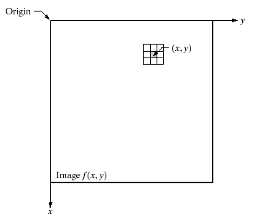
Displaying an image(cont.)
Spatial domain

Slide 34
Displaying an image(cont.)
pixval :
function:cursor on image to show pixel values
usage: imshow(I),pixval

Slide 35
Displaying an image(cont.)
colorbar
function:To display an image with a colorbar that indicates the range of intensity values.
usage： imshow(I), colorbar
ex:
I = imread('pout.tif');
imshow(I) , colorbar

Slide 36
Writing an image
imwrite()
Function: write an image into a file.
usage： imwrite(I,filename,format)
ex:
imwrite(I,'pout.jpg‘,’JPEG’);

Slide 37
Image information
Image size: size()
ex:
I= imread('saturn.png');
size(I)
[M,N] = size(I)
M=the height of the image I
N=the width of the image I

Slide 38
Image information
whos
function: display information about an image .
ex: whos I
Imfinfo( filename )
function: display information about image file .
ex: info = imfinfo('saturn.png')

Slide 39
Digital Image processing
g = im2bw(I, T);
function: Convert intensity image I to binary image g using threshold T, where T must be in range [0, 1].
ex:
I= imread('pout.tif');
g = im2bw(I, 0.4);
imshow(g) ,colorbar

Slide 40
Digital Image processing(cont.)
Rgb2gray()
Function: convert a color image into a grey image.
ex:
I= imread ('saturn.png');
g = rgb2gray(I);
imshow(g), colorbar

Slide 41
Digital Image processing(cont.)
imcomplement( )
function:The negative of an image.
ex: J = imcomplement(g);
imshow(J),

Slide 42
Digital Image processing(cont.)
Resize a image
imresize(I,scale,method);
function:To change the size of an image.
interpolation Method:
-'nearest‘ :Nearest-neighbor interpolation
-'bilinear‘ :Bilinear (the default)
-'bicubic‘ :Bicubic interpolation

Slide 43
Digital Image processing(cont.)
ex:
I = imread('circuit.tif');
J = imresize(I,1.25);
imshow(I)
figure, imshow(J)
ex:
I = imread('circuit.tif');
J = imresize(I,[100 150], 'bilinear');
imshow(I)
figure, imshow(J)

Slide 44
Digital Image processing(cont.)
imrotate(I, angle);
function: To rotate an image.
ex:
I = imread('pout.tif');
J = imrotate(I,35);
imshow(J)

Slide 45
More Example
Using affine transformation
1.Rotation 45 degree
I=imread('spokes1.bmp');
T = maketform('affine',[cosd(45) -sind(45) 0; sind(45) cosd(45) 0; 0 0 1]);
tformfwd([10 20],T);
I2 = imtransform(I,T);
imshow(I2)

Slide 46
More Example(cont.)
2.Translation
I=imread('spokes1.bmp');
move = translate(strel(1), [25 30]);
H = imdilate(I,move);
imshow(H)

Slide 47
More Example(cont.)
3.shear
I=imread('spokes1.bmp');
T = maketform('affine',[1 0 0; 1 2 0; 0 0 1]);
tformfwd([10 20],T);
I2 = imtransform(I,T);
imshow(I2)

Slide 48
More Example(cont.)
Edge detectors
1.Sobel edge detector
Code://Both horizontal and vertical
I=imread('bridge.jpg');
BW=rgb2gray(I);
BW2=edge(BW,'sobel',0.02,'both');
figure,imshow(BW2)

Slide 49
More Example(cont.)
2.the Canny method
low threshold: 0.04,high threshold: 0.10 , sigma is 1
Code:
I=imread('bridge.jpg');
BW=rgb2gray(I);
BW4 = edge(BW,'canny',[0.04 0.10],1);
figure,imshow(BW4)

Slide 50
More Example(cont.)
Filter(mean filter)
Code:
I = imread('coins.png');
h = ones(5,5) / 25;
I2 = imfilter(I,h);
imshow(I), title('Original Image');
figure, imshow(I2), title('Filtered Image')

Slide 51
More Example(cont.)
Filter(unsharp masking filter )
Code:
I = imread('cameraman.tif');
h = fspecial('unsharp');
I2 = imfilter(I,h);
imshow(I), title('Original Image')
figure, imshow(I2), title('Filtered Image')

Slide 52
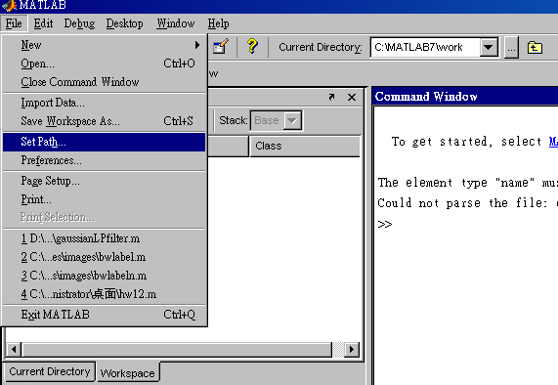
Set path

Slide 53
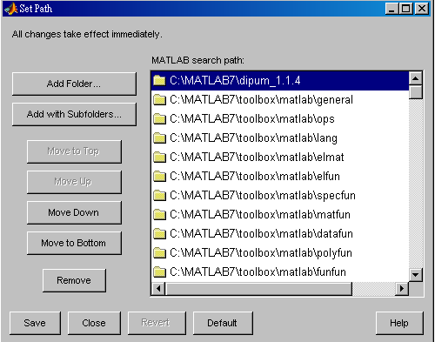
Set path (cont.)

